Slide 1

IRS AssignmenT Task 3
Muhammad Wajeeh Uz Zaman

Slide 2
Task3Core.py
A File That Contains Following Functions:
getidbydocument
getdocumentbyid
defgetwordbyid
defgetidbyword
rawtermfrequency
logtermfrequency
NumberOfTermsinDocument
loadN
IDF
TF_IDF
compute_K
average_document_length
BM25

Slide 3
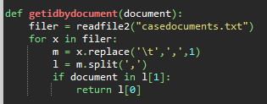
getidbydocument
Function that gives id of opened or document in loop. We need it to append with tf, idf and bm25

Slide 4
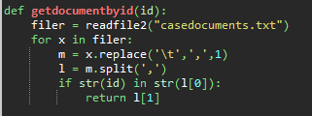
getdocumentbyid
Function that gives name of document by giving id in loop. We need it to append with tf, idf and bm25

Slide 5
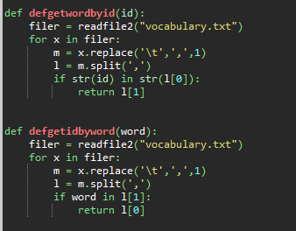
defgetwordbyid and defgetidbyword
Do The same as in documents but for vocabulary

Slide 6
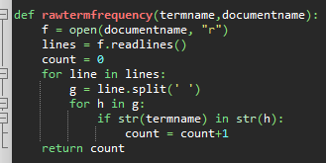
rawtermfrequency
count number of terms in a particular document.

Slide 7

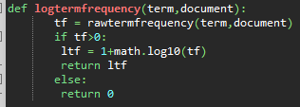
logtermfrequency
gives log of term freqency in a particular document

Slide 8
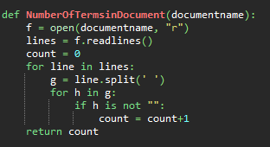
NumberofTermsinDocument
Gives us Total numer of terms in a document that we may need in BM25

Slide 9
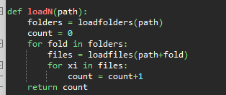
loadN
Gives the size of corpus for BM25

Slide 10

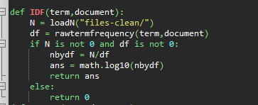
IDF
Gives IDF of a particular term in particular document

Slide 11

TF-IDF
It Gives TF-ID of a particular term in a particular document

Slide 12
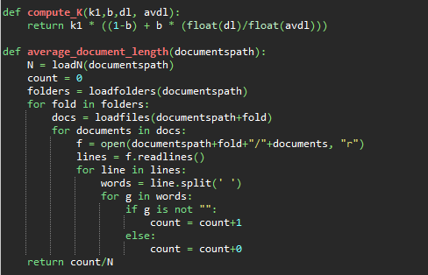

ComputeK and averageDocumentlength
Functions for BM25

Slide 13
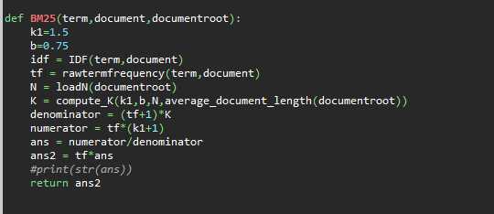
BM25
BM25 Function. Default values of k and b are taken as 1.5 and 0.75 respectively

